Slide 1
SOFTWARE ENGINEERING PROJECT SCANNO-3D
Rahul Pandey - MAIA
Majeed Hussain - MSCV
Zafar Toshpulatov - MAIA

Slide 2
Overview
Introduction
Traditional point cloud Alignment
Proposed Modern Technique for Point Cloud Alignment
Changing outlier
Performance Analysis of Rigid 3D Point Cloud Registration Algorithms
Registration algorithms
Results and discussion
Conclusions and Future work

Slide 3
Introduction
In this project we have tried to propose a new approach which if used with registration phase gives more efficiency and effectiveness to the results.
3D point cloud registration is a fundamental and critical issue in 3D reconstruction and object recognition. Most of the existing methods are based on local shape descriptor. Here, we propose a Regional Curvature Map (RCM) method. Based on the RCM, an efficient and accurate 3D point cloud registration method is presented.

Slide 4
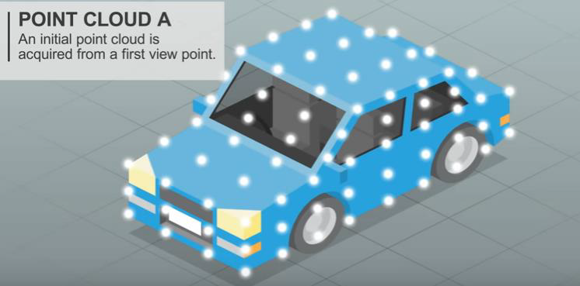
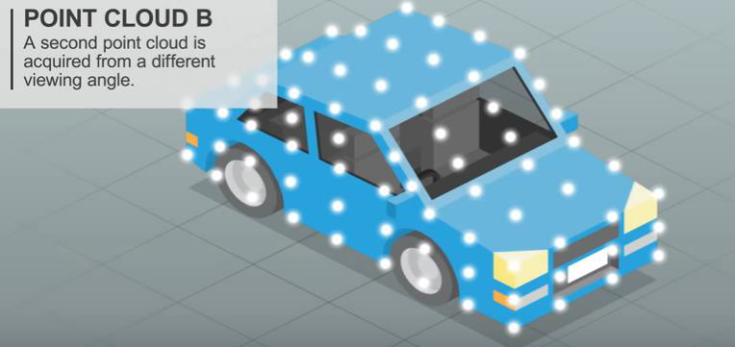
Traditional point cloud Alignment
Suppose an object requires a 360-degree 3D digitization. An initial point cloud is acquired from a first view point. A second point cloud is acquired from a different viewing angle. If the relative camera position is unknown the two-point clouds cannot be easily aligned with current technology.
Initial Point Cloud A
Initial Point Cloud B

Slide 5
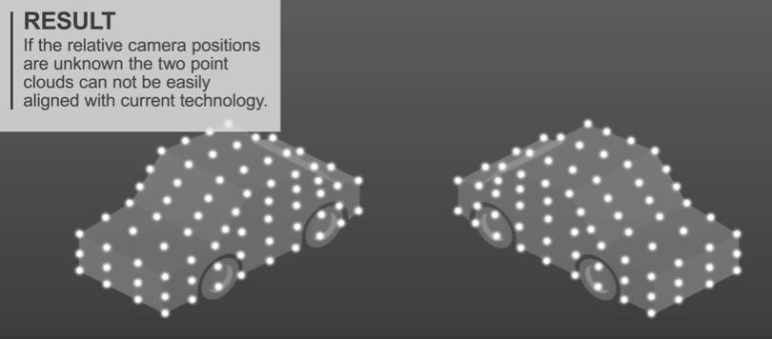
Traditional point cloud Alignment
As any registration problem, range registration consists of the steps of matching and estimation of the rigid transformation. Depending on the displacement and orientation between point clouds, we differentiate between crude and fine. The challenge in crude registration lies in performing it automatically and consistently even when there is very small overlap. The golden standard for fine registration is the Iterative Closest Point algorithm and its variants. ICP techniques either assume a rough alignment of the two-point sets or run the algorithm multiple times by sampling the space of initial conditions. Robust variations like RANSAC reject outliers and improve the estimation of the rigid transformation.
Two frames
of object

Slide 6
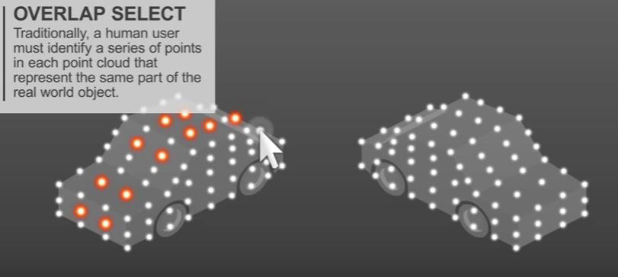
Traditional point cloud Alignment
Traditionally a human user must identify a series of points in each point cloud that represent the same part of the real-world object.
Identification of Series of point on Cloud A.

Slide 7
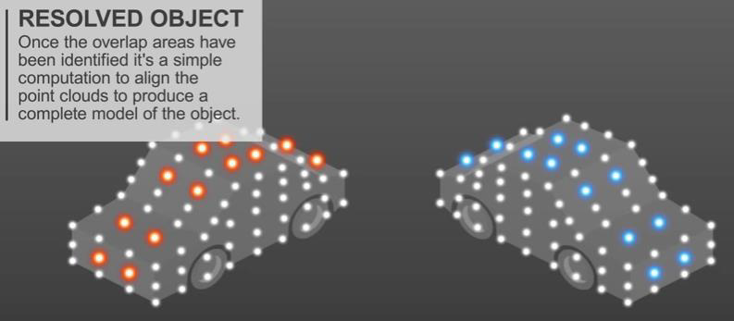
Traditional point cloud Alignment
Once the overlapped areas have been identified it is a simple computation to align the point clouds to produce a complete model of the object.
Identification of Series of point on Cloud B.

Slide 8
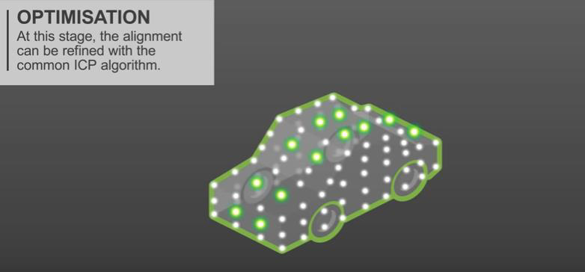
Traditional point cloud Alignment
This process has the potential to be time consuming and incorrect. It also becomes impractical processing multiple point clouds such as in video. At this stage the optimization needs to be done and so the alignment can be refined with the common ICP algorithm.

Slide 9
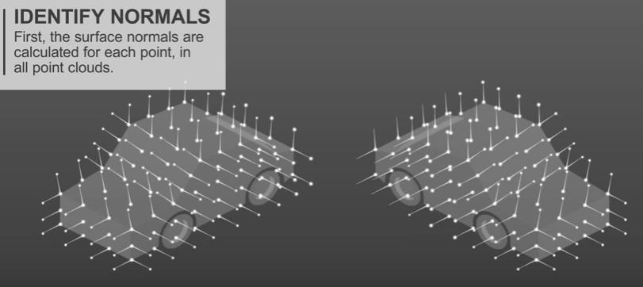
Proposed Modern Technique for Point Cloud Alignment
In a different technique the 3D point cloud registration can be done using identifying normal. First the surface normal are calculated for each point, in all point clouds, the normal are collected on a common origin forming clusters on a sphere.
Surface Normal for all Points

Slide 10
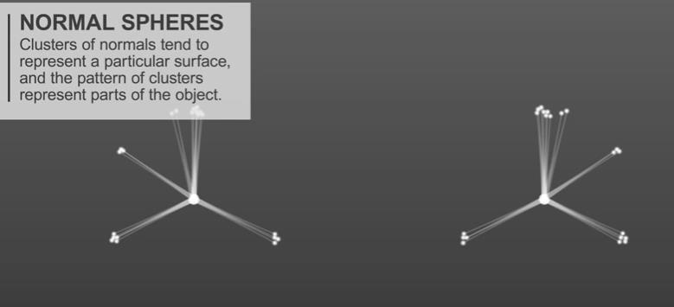
Proposed Modern Technique for Point Cloud Alignment
Clusters of normal tend to represent a surface, and the pattern of clusters represent part of the object.
Clustering at Origin

Slide 11
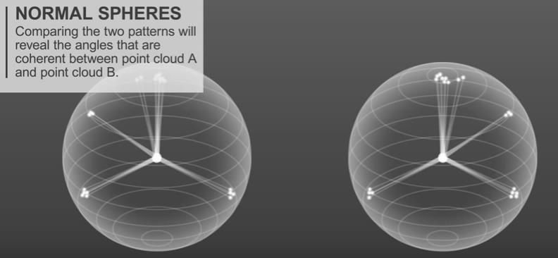
Proposed Modern Technique for Point Cloud Alignment
Comparing the two patterns will reveal the angles that are coherent between point cloud A and point cloud B.
Comparison of Normal Spheres

Slide 12
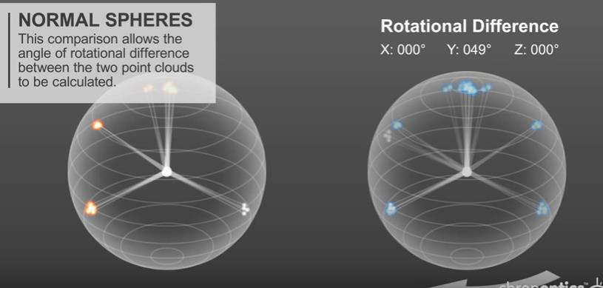
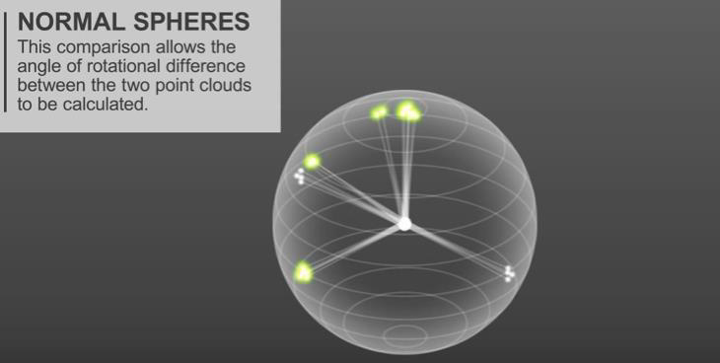
Proposed Modern Technique for Point Cloud Alignment
This comparison allows the angle of rotational difference between the two-point clouds to be calculated.
Rotational Difference Calculation
Overlapping of two Normal Spheres.

Slide 13
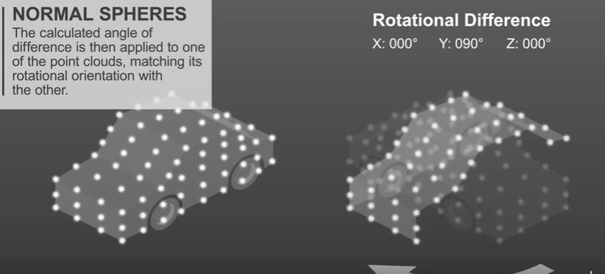
Proposed Modern Technique for Point Cloud Alignment
The calculated angle of difference is then applied to one of the point clouds, matching its rotational orientation with the other. The final step is simply to translate one-point cloud over to the other until it overlaps.
Difference angle applied to point clouds.

Slide 14
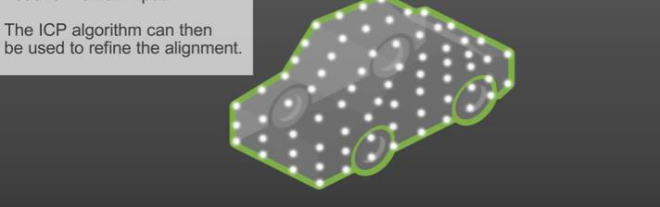
Proposed Modern Technique for Point Cloud Alignment
The result is a course alignment of point clouds with large unknown separation angles. The ICP algorithm can be then used to refine the alignment.
ICP algorithm for refinement

Slide 15
Changing outlier
There are several different methods in the filter module to remove outliers from a Point Cloud. In the previous case statistical outlier removal method was used which works fine for outlier removal. For the improvement purpose we look at how to use a Conditional Removal filter which removes all indices in the given input cloud that do not satisfy one or more given conditions. Then we tried how to use a Radius Outlier Removal filter which removes all indices in its input cloud that don’t have at least some number of neighbors within a certain range.
The final output shows no improvement in terms of efficiency and precision for outlier removal and it seems that Conditional Removal filter and Radius Outlier Removal filter are not the best methods to use for outlier removal.

Slide 16
Performance Analysis of Rigid 3D Point cloud Registration Algorithms
The registration algorithms can be classified coarsely into rigid and non-rigid approaches. Rigid approaches assume a rigid environment such that the transformation can be modeled using only 6 Degrees of Freedom (DOF). Non-rigid methods on the other hand, can cope with articulated objects or soft bodies that change shape over time.
Most of these employs either a simple Singular Value Decomposition (SVD) or Principal Component Analysis (PCA) based registration, or use a more advance iterative scheme based on the Iterative Closest Point (ICP) algorithm.

Slide 17
Registration algorithms
We discuss 4 widely used rigid registration algorithms:
Principal Component Analysis
Singular Value Decomposition
Iterative Closest Point
Generalized ICP

Slide 18
A. Principal Component Analysis
PCA is often used in classification and compression techniques to project data on a new orthonormal basis in the direction of the largest variance. The direction of the largest variance corresponds to the largest eigenvector of the covariance matrix of the data, whereas the magnitude of this variance is defined by the corresponding eigenvalue.

Slide 19
B. Singular Value Decomposition
PCA based registration simply aligns the directions of the largest variance of each point cloud and therefore does not minimize the Euclidean distance between corresponding points of the datasets. Consequently, this approach is very sensitive to outliers and only works well if each point cloud is approximately normally distributed.

Slide 20
C. Iterative Closest Point
Point correspondences between these point clouds are defined based on a nearest neighbor approach or a more elaborate scheme using geometrical features or color information.
SVD, is used to obtain an initial estimate of the affine transformation matrix that aligns both point clouds. After registration, this whole process is repeated by removing outliers and redefining the point correspondences. Two widely used ICP variants are the ICP point-to-point and the ICP point-to-surface algorithms. These approaches only differ in their definition of point correspondences.
ICP point-to-point: The ICP point-to-point algorithm simply obtains point correspondences by searching for the nearest neighbor target point qi of a point pj in the source point cloud.
ICP point-to-surface: The ICP point-to-surface algorithm assumes that the point clouds are locally linear, such that the local neighborhood of a point is co-planar. This local surface can then be defined by its normal vector n, which is obtained as the smallest eigenvector of the covariance matrix of the points that surround correspondence candidate qi.

Slide 21
D. Generalized ICP
Generalized ICP algorithm is proposed which performs plane-to-plane matching. They introduced a probabilistic interpretation of the minimization process such that structural information from both the source point cloud and the target point cloud can be incorporated easily in the optimization algorithm. Moreover, they showed that the traditional point-to-point and point-to-surface ICP algorithms are merely special cases of the Generalized ICP framework.

Slide 22
Results and discussion
We illustrate the performance difference between a naive PCA based approach, a correspondence based SVD approach, and the ICP point-to-point registration approach.
Comparison between
PCA, SVD and general
point to point ICP

Slide 23
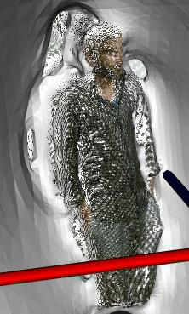
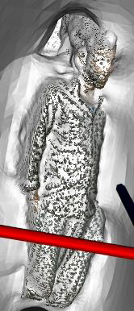
Conclusions and Future work
Results of our registration algorithm to be good enough considering the technical difficulty, initial skills and knowledge, available time and mentoring and organization overhead in the project. We have provided an algorithm that can successfully register 3D objects with as few as 10 frames while providing a rough registration preview in real-time. It is also robust to rough parameter estimation and errors in the pre alignment of some frames.
Future work should focus mainly on reducing the noise and misalignment derived from sensor noise and non-rigid object registration.
Meshing result 1 and result 2

Slide 24
Thank you for your attention!

